Slide 1
Disk of Charge

Slide 2
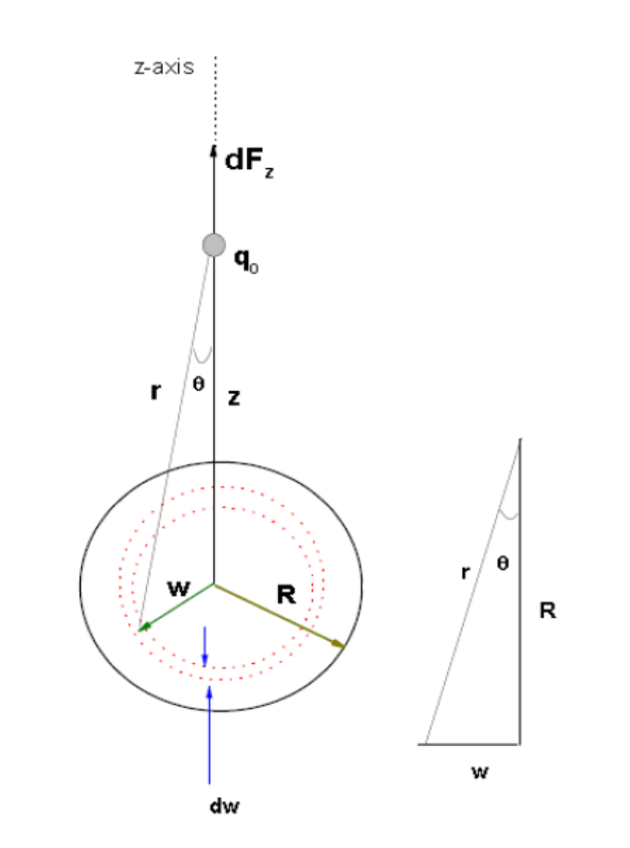

Slide 3

2πw is length of the ring
$σ=\frac{dq}{dA}$, where $dA=2πwdw$
dw is thickness of ring
Force due ring calculated earlier,
Replace q by dq here, R by w and then

Slide 4
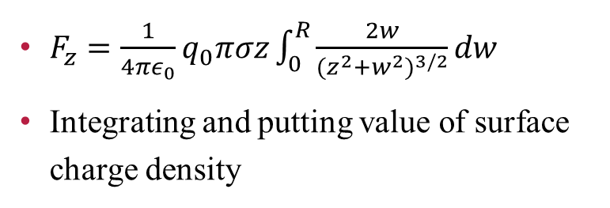
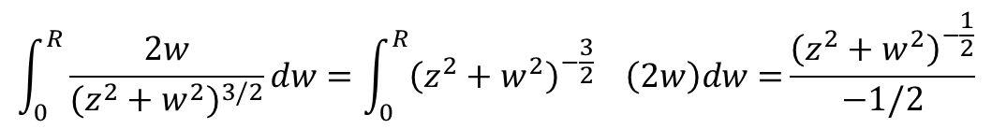
$F_{z}=\frac{1}{4πε_{0}}q_{0}πσz\int_{0}^{R}{\frac{2w}{{(z^{2}+w^{2})}^{3/2}}dw}$
Integrating and putting value of surface charge density
$$\int_{0}^{R}{\frac{2w}{{(z^{2}+w^{2})}^{3/2}}dw={\int_{0}^{R}{{\left(z^{2}+w^{2}\right)}^{−\frac{3}{2}}}}^{}\left(2w\right)dw=}\frac{{\left(z^{2}+w^{2}\right)}^{−\frac{1}{2}}}{−1/2}$$
R
0
=$−2[\frac{1}{{\left(z^{2}+R^{2}\right)}^{\frac{1}{2}}}−\frac{1}{{{(z}^{2})}^{\frac{1}{2}}}]=2(\frac{1}{z}−\frac{1}{\sqrt{\left(z^{2}+R^{2}\right)}})$
What will happen to this electric field if R approaches infinity.

Slide 6


$$E=o$$
$$E=\frac{1}{4πε_{0}}\frac{q}{r^{2}}$$

